Slide 1

Generating Image Captions based on Deep Learning and Natural language Processing
by
M. Bhargavi
Roll No. 204G1A0521
G. Jasmin
Roll No. 204G1A0542
P. Manjusha
Roll No. 204G1A0552
A. Anulekha Sai
Roll No. 214G5A0504
Under the guidance of
Mrs. P. Rohini M. Tech
Assistant Professor
Department of Computer Science and Engineering
Srinivasa Ramanujan Institute of Technology
(Autonomous)
2023 - 2024

Slide 2

Contents
Abstract
Introduction
Literature survey
Existing System
Proposed System
Planning
Design
Implementation
Conclusion
Research Paper
References

Slide 3
Abstract
Humans and computers are attempting to communicate because everything in today's society depends on systems like computers, mobile phones, etc. This is how our project is visualized. Our undertaking People with visual impairments can benefit from the creation of image captions. Computers are unable to distinguish objects, things, or activities with the same ease as humans. To recognize them, they require some training. The suggested method is used to identify activities or similar items. We offer several deep neural network-based models for creating captions for images, with a particular emphasis on CNNs (Convolutional Neural Networks) that extract characteristics from the image.

Slide 4
Continue….
Using LSTM (Long Short-Term Memory) techniques, RNNs (Recurrent Neural Networks) create captions based on the image's attributes. and examining how they affect the construction of sentences. Here, encoder-decoders are used to create a link between descriptions from natural language processing and visual information such as image features. The process of generating a caption's sequence is handled by the decoder, while the encoder extracts features. In order to determine which feature extraction and encoder model produces the best results and accuracy, we have also created captions for sample photos and compared them with one another. We also introduce Deep Voice, a text-to-speech system of production quality that uses only deep neural networks to generate captions based on visual attributes. The evaluation of our project will be conducted utilizing several machine learning methods and Python.

Slide 5
Introduction
It is relatively easy for humans to describe the environments they are living. It is normal for a human to be able to quickly describe a vast amount of information about an image. This is a fundamental human ability. The ability to identify objects and describe images is facilitated by the human brain. Artificial Intelligence introduces numerous algorithms that are based on the architecture of the brain. To allow a computer to automatically explains an image, Image captioning came into picture.
The existing image captioning systems face challenges in generating accurate and contextually relevant descriptions, often resulting in inadequate or inaccurate captions.
The main problem addressed by this project is the development of an innovative system to produce comprehensive and precise image captions by exploiting both global and specific image features. Also, provide the audio for the captions.

Slide 6
Literature survey
[1]. In this paper, deep neural networks have enabled the captioning of images. Based on the dataset, the photo caption generator assigns a suitable title to an applied input image. The proposed study suggests a deep learning-based model and applies it to produce a caption for the input image. The model uses both CNN and LSTM algorithms. This CNN model recognizes the objects in the picture, and the Long Short-Term Memory (LSTM) algorithm generates text as well as caption that fits the project. Thus, the proposed model combines both object recognition and title generation for the input images.
[2]. In this paper, The keras framework's TensorFlow backend has been utilized in this study's model evaluation. Utilizing assessment measures that were appropriate for the problem's nature allowed for an understanding of how The model has made correct predictions. This paper presents the results of mathematical computations performed on the confusion matrix.

Slide 7
Literature survey
[3]. The proposed system for the project “Design and implementation of text to speech conversion for visually impaired people" is a sophisticated and versatile solution that developed a useful text-to-speech synthesizer in the form of a simple application that converts inputted text into synthesized speech and reads out to the user.
[4]. The main difficulties in this research include identifying the objects in an image and their characteristics, which are challenging computer vision problems, as well as figuring out how the objects interact and what relationships exist between them. Automatic image description is not without its difficulties. To improve the model's performance, the authors trained it over several layers (or levels) using CNN .
[5]. The project specifies the use of the Flickr8k dataset for training and testing which is significantly good. The BLEU score is used as an evaluation metric to assess the quality of generated captions.

Slide 8
Existing System
In the existing system, image captioning typically involves a two-step process: feature extraction using Convolutional Neural Networks (CNNs) and caption generation utilizing recurrent neural networks (RNNs).
DISADVANTAGES
Limited Understanding of Long-Term Dependencies: RNNs suffer from difficulties in capturing long-term dependencies in sequential data. In the context of image captioning, where the relationship between words in a sentence is crucial, this limitation may result in the model struggling to maintain context over extended captions.
Inability to Capture Global Context: CNNs are excellent at extracting local features from images, but they might lack the ability to capture global context and relationships between different objects or scenes within an image.

Slide 9
Continue…
This limitation can impact the model's understanding of complex visual scenes, potentially leading to inaccurate or incomplete captions.
Fixed-size Image Representations: CNNs produce fixed-size feature vectors regardless of the input image size. This fixed-size representation may not fully capture the diversity of visual content, leading to information loss for images with varying complexities or compositions.
Difficulty in Handling Rare Words: RNNs may struggle with generating rare or unseen words, as they heavily rely on the training data. Uncommon words or specific vocabulary may not be adequately represented in the training set, leading to challenges in captioning novel or specialized images.

Slide 10
Proposed System
Our proposed system employs combination of ResNet-50 and LSTM ensures a seamless fusion of visual and linguistic information. The ResNet-50 feature vector serves as a foundation for the LSTM to generate contextually relevant captions, effectively marrying the strengths of both modalities. The proposed architecture aims to overcome challenges associated with understanding complex visual scenes and maintaining linguistic context, ultimately leading to improved image captioning performance. The use of ResNet-50 as a feature extractor and LSTM for sequence modeling represents a state-of-the-art approach in the field, aligning with contemporary advancements in deep learning for multimodal tasks. And our proposed system provides audio for the relevant audio for the generated captions utilizing text-to-speech library which will help to visually impaired people.

Slide 11
Continue
Advantages:
1.Rich Visual Representations:ResNet-50: ResNet-50, a powerful convolutional neural network, excels at capturing rich visual features from images. Its deep architecture allows it to learn hierarchical representations, enabling the extraction of intricate details and patterns.
2.High-Level Semantic Features:ResNet-50: ResNet-50 provides high-level semantic features that go beyond simple object detection. This is crucial for generating captions that not only describe objects but also capture the semantic context and relationships within a scene.
3.Effective Handling of Varied Image Sizes: ResNet-50: ResNet-50 can handle images of various sizes without requiring manual resizing. This flexibility is advantageous when working with datasets containing images of different resolutions.

Slide 12
Planning
Objective-1:To develop a deep learning-based image captioning model that surpasses the current state-of –art performance in terms of captioning accuracy. We are using flickr30k model to provide accurate captions.0
Objective-2:To provide audio for the generated captions. Generated textual captions into spoken audio using a Text-to-Speech (TTS) system. TTS systems take text input and produce corresponding speech output.
Scope: Scope of this project are:
Accessibility Enhancement
Multimodal AI Development
Real-world Applications
Deep Learning Benchmarking

Slide 13
Planning
Functional Requirements:
Authentication of user whenever he/she logs into the system.
System shutdown in case of a cyber-attack.
A verification email is sent to user whenever he/she register for the first time on some software system.
Non-functional Requirements:
Portability
Security
Maintainability
Reliability
Scalability
Performance
Flexibility

Slide 14
Planning
Software Requirements:
Operating System : Windows 7+
Server side Script : HTML, CSS, Bootstrap & JS
Programming Language : Python
Libraries : Flask, Pandas, Mysql.connector, Os, Smtplib, Numpy
IDE/Workbench : PyCharm
Technology : Python 3.6+
Server Deployment : Xampp Server
Database : MySQL
Hardware Requirements:
Processor - I3/Intel Processor
Hard Disk - 160GB
Key Board - Standard Windows Keyboard
Mouse - Two or Three Button Mouse
Monitor - SVGA
RAM - 8GB

Slide 15
Planning
1 Long Short Term Memory:
1.1 Sequence Modeling:
In the context of image captioning, LSTMs are used to model sequential information, such as generating a sequence of words in a sentence. The LSTM is employed as the decoder part of the image captioning model, taking as input the features extracted from the image.
1.2 Image Feature Input:The LSTM receives the image features (extracted by a pre-trained CNN like ResNet) as an initial input.
1.3 Word Generation:
The LSTM generates words one at a time, considering the context provided by the image features and the previously generated words. At each time step, the LSTM produces a probability distribution over the vocabulary, and a word is sampled from this distribution.

Slide 16
Planning
1.4 Recurrent Connection:
LSTMs have recurrent connections that allow them to maintain and update an internal memory state, which helps capture long-term dependencies in the sequence.
The internal state is updated at each time step based on the input features and the previously generated word.
1.5 Training: During training, the model is optimized to minimize the difference between the predicted caption and the ground truth caption.

Slide 17
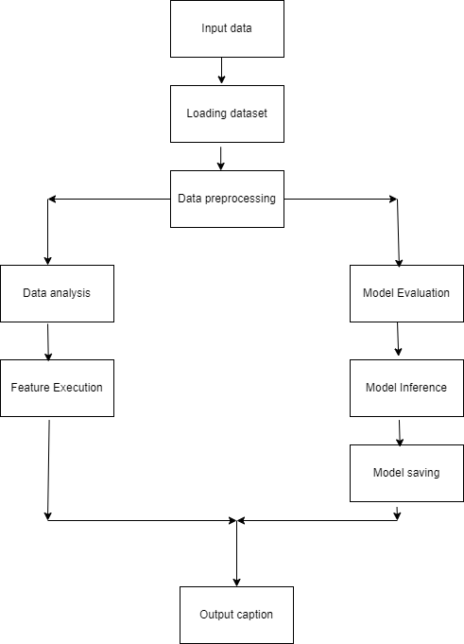
Design
Figure1.: Block Diagram

Slide 18
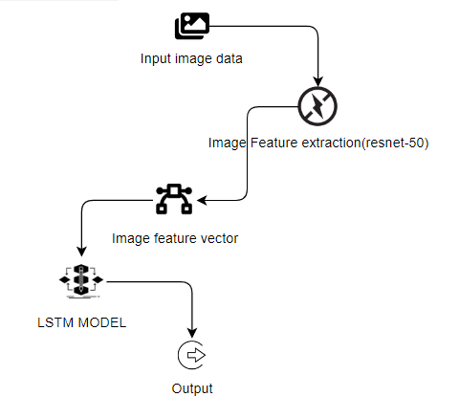
Design
Figure1.: Architecture

Slide 19
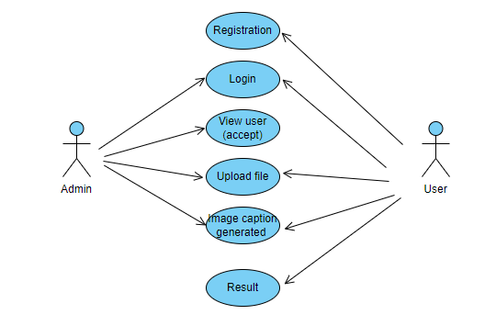
Design
Figure: Architecture
Figure2.: Use Case Diagram

Slide 20
Design
1 System
1.1 Create Dataset: The dataset containing images and text data of the desired objects to be captioned is split into training and testing dataset with the test size of 20-30%.
1.2 Pre-Processing: Data preprocessing is a crucial step in the data analysis pipeline where raw data is transformed, cleaned, and organized to make it suitable for analysis by machine learning algorithms. Resizing and reshaping the images into appropriate format to train our model.
1.3 Training: Data training, often referred to simply as training, is a fundamental concept in machine learning and artificial intelligence. Use the pre-processed training dataset is used to train our model using RESNET-50 and LSTM algorithm.

Slide 21
Design
1.4 Pre-Training: The ResNet model is used as a feature extractor for images. The model is typically pre-trained on a large dataset for image classification tasks (e.g., ImageNet). The weights learned during pre-training capture hierarchical and abstract features in images.
1.5 Feature Extraction: Given an input image, the pre-trained ResNet model is used to extract features from intermediate layers. The features represent high-level visual information present in the image.
1.6 Integration with Captioning Model: The extracted image features are then passed to the decoder part of the image captioning model. The decoder, often implemented as a recurrent neural network (RNN) or transformer, generates a textual description of the image based on the input features.

Slide 22
Design
2 User
2.1 Register: The user needs to register and the data stored database.
2.2 Admin login: Admin logs in into the administrator login and views the user registered list, once he accepts the user data only then the user will be allowed to login.
2.3 Login: A registered user can login using the valid credentials to the website to use a application.
2.4 Upload Image: The user has to upload an image which needs to be Captioned the images.
2.5 Prediction: The results of our model will display the caption of image we have assigned to it.
2.6 Logout: Once the prediction is over, the user can logout of the application.

Slide 23
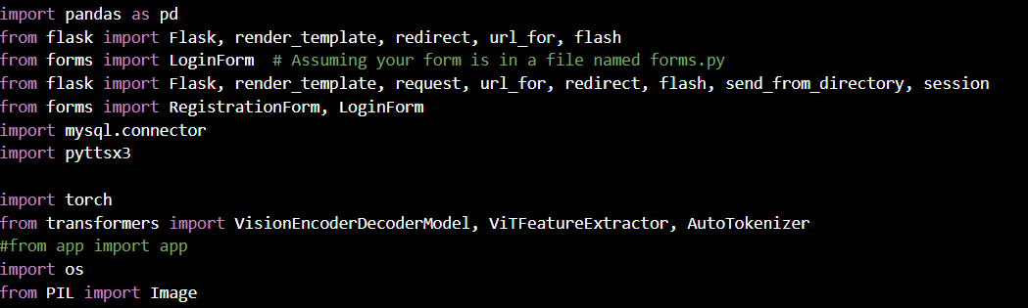
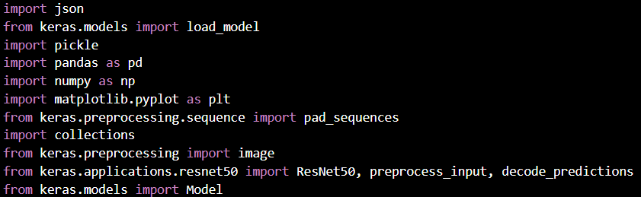

Implementation
Figure.: Importing libraries

Slide 24
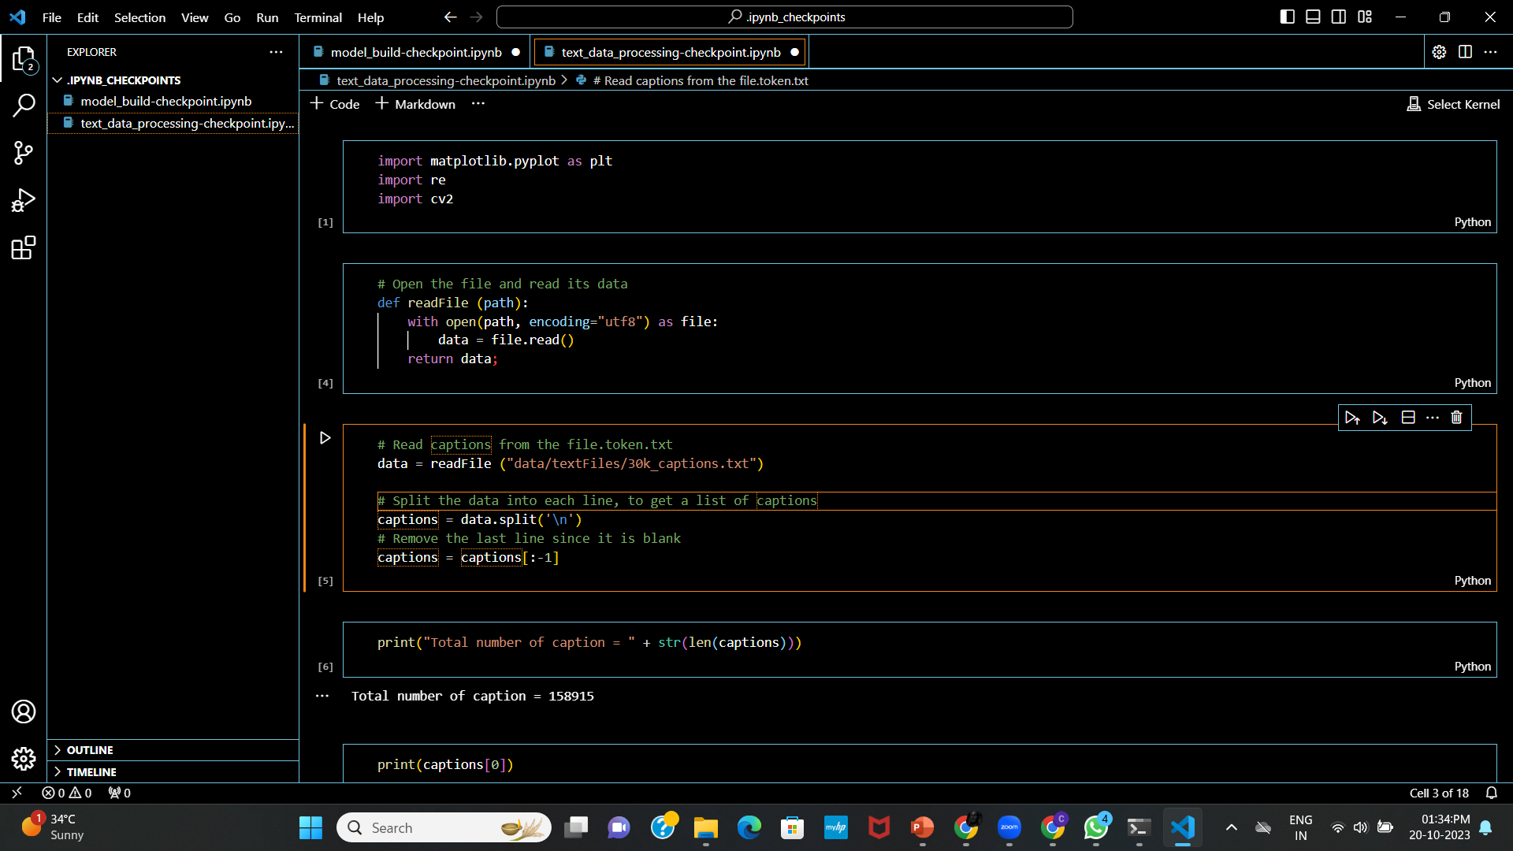
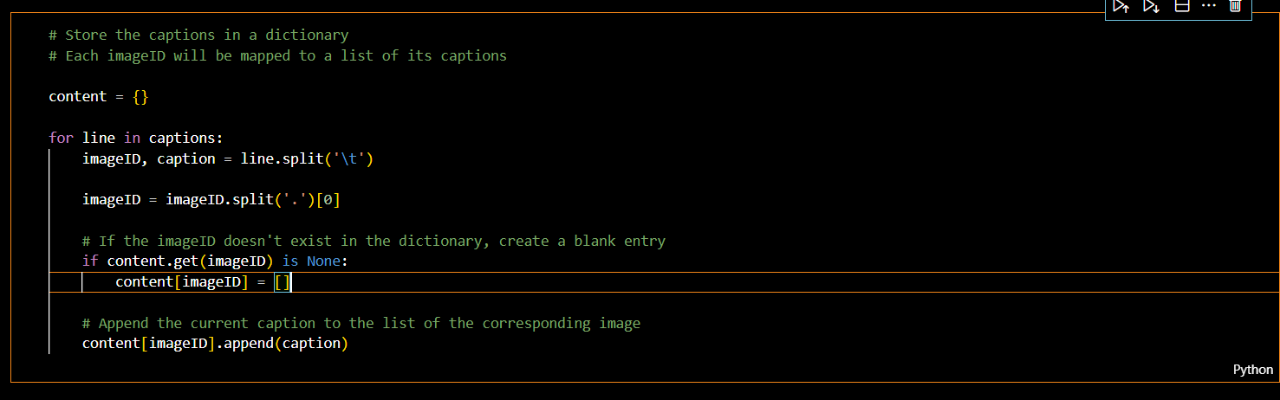
Implementation
Figure.: Text data processing

Slide 25
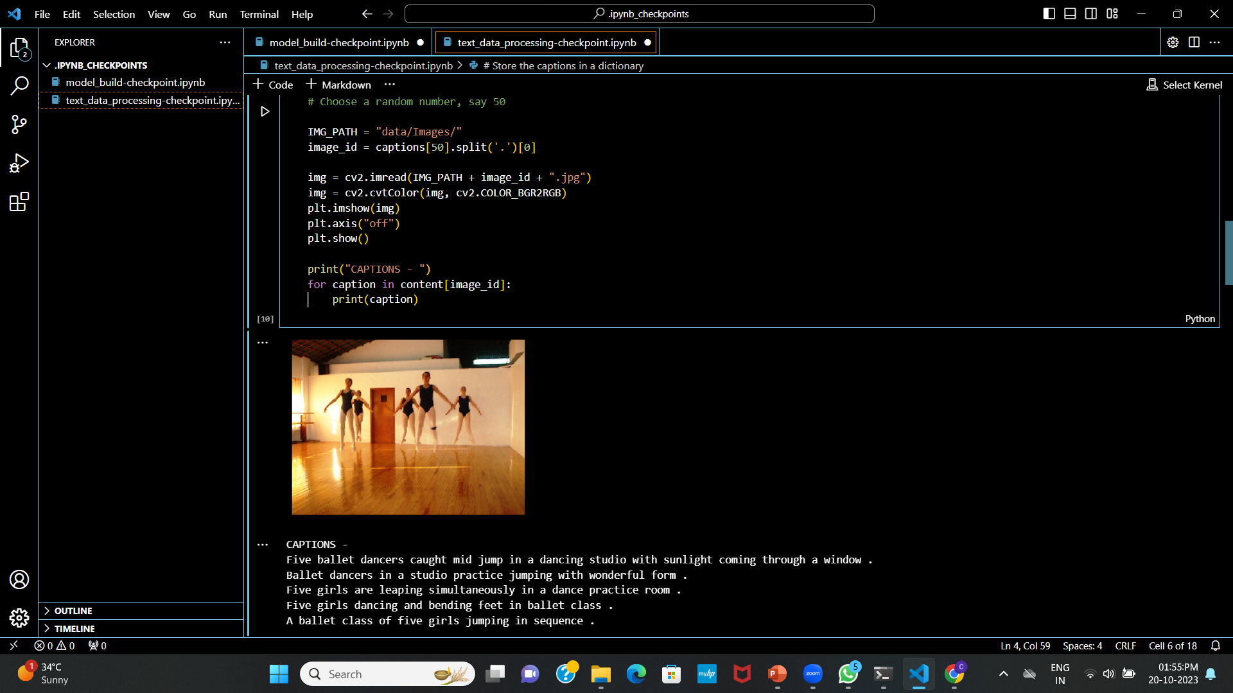
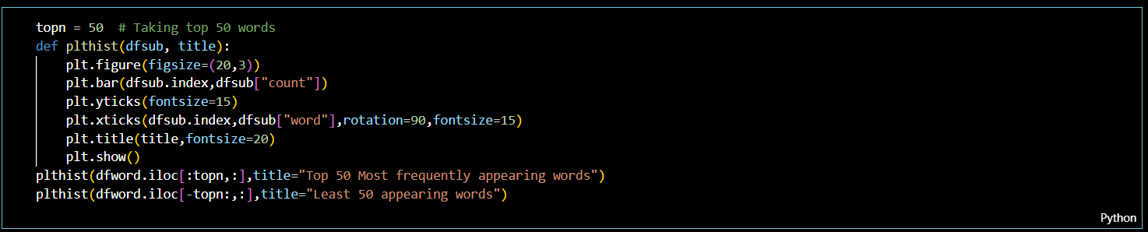
Implementation
Figure.: Mapping captions to the images

Slide 26
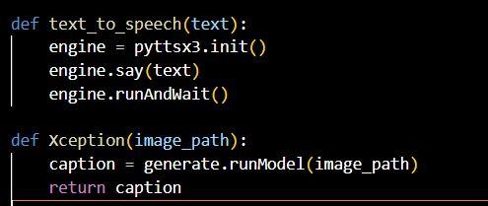
Implementation
Figure.: Generating audio for the caption

Slide 27
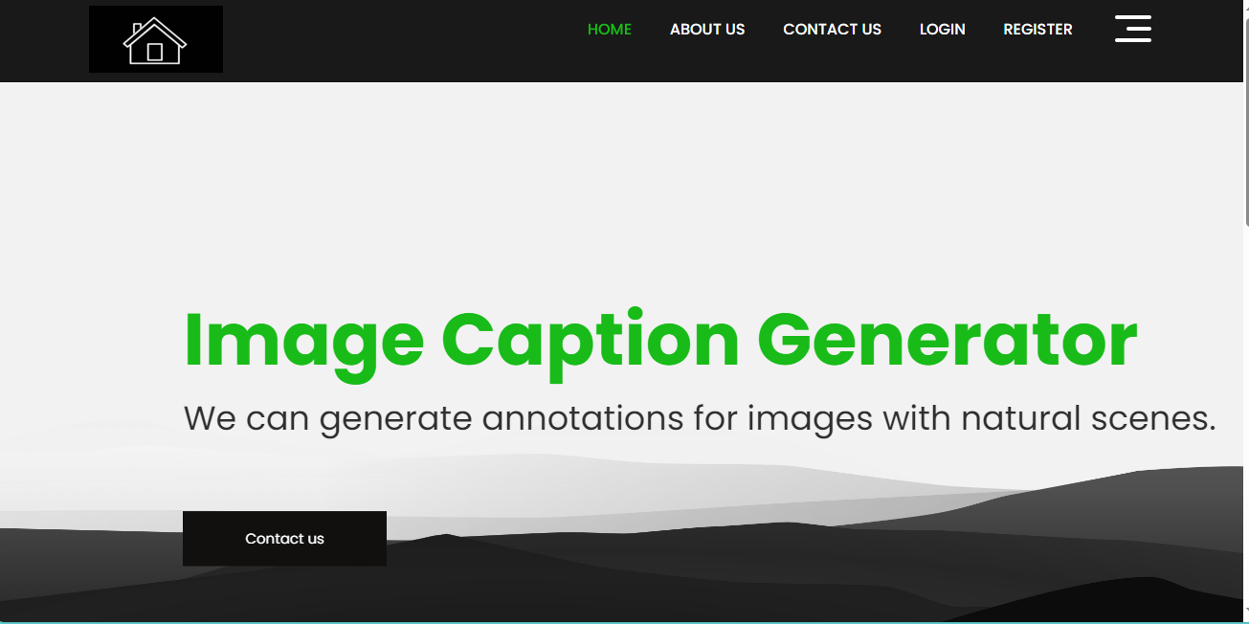
Results
Home Page:

Slide 28
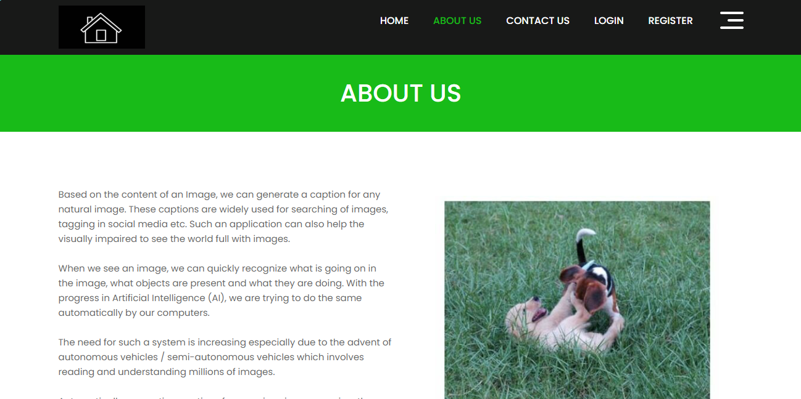
Results
About Us:

Slide 29
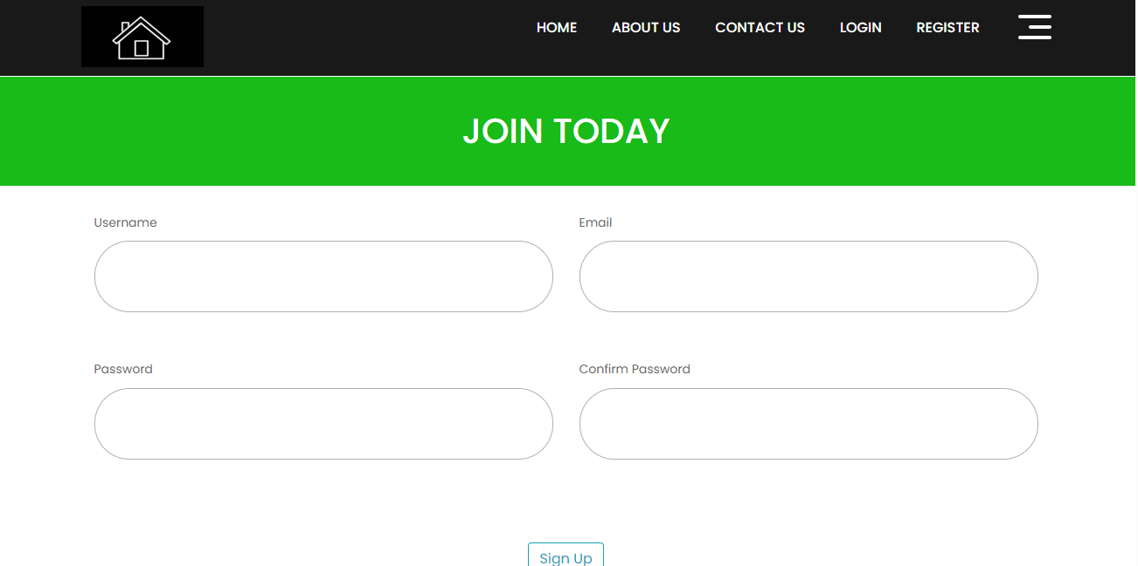
Results
Register Page:

Slide 30
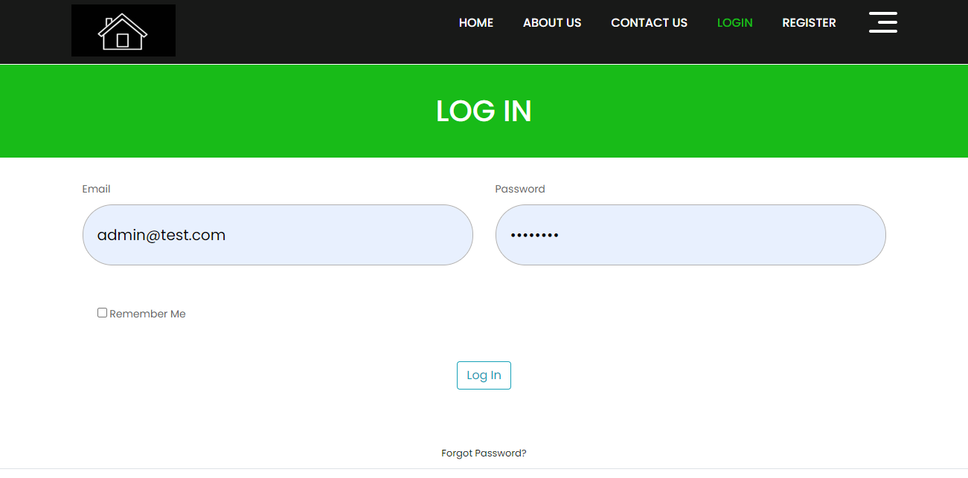
Results
Login Page:

Slide 31
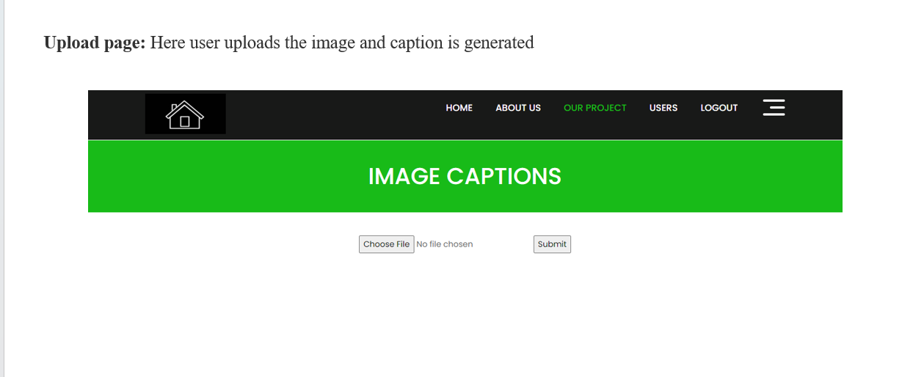
Results
Upload Page:

Slide 32
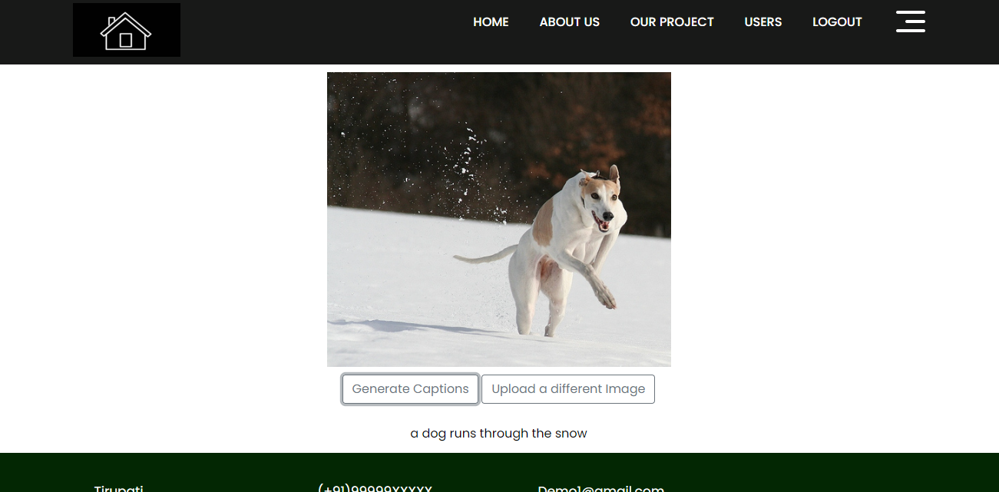
Results
Result:

Slide 33
conclusion
The issue of creating meaningful captions for images has been found to be powerfully and effectively solved by the image caption generator that combines Long Short-Term Memory (LSTM) networks with Convolutional Neural Networks (CNNs). Using CNN layers to obtain relevant characteristics and capture spatial information, the CNN-LSTM model showed how to generate contextually relevant captions by efficiently utilizing LSTM layers. Visual perception and sequential data processing work together to address the problems of picture understanding and natural language synthesis through the integration of these two architectures. This work emphasizes the need of merging all the layers to produce better results from challenging tasks like image captioning.

Slide 34
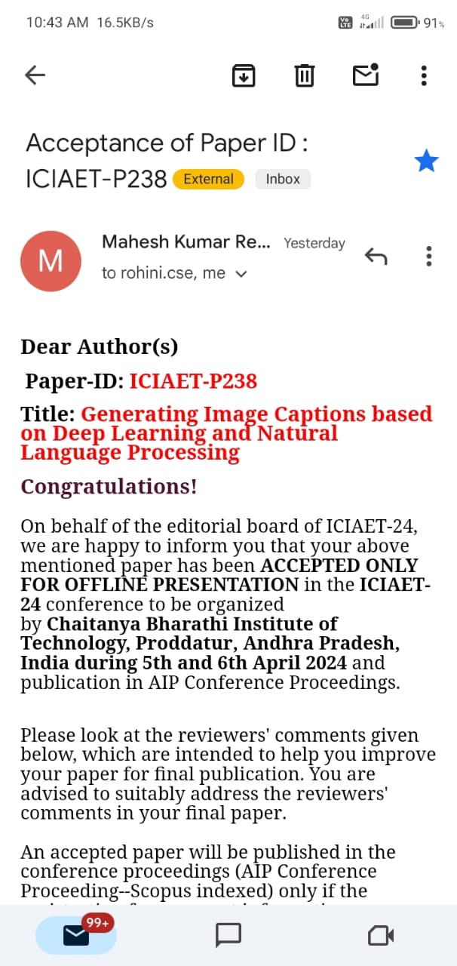

Research Paper
Acceptance from CBIT Payment Proof

Slide 35
References
[1]. M Sailaja, K Harika, B Sridhar. Rajan Singh, “Image Caption Generator using Deep Learning”, 2022 International Conference on Advancements in Smart, Secure and Intelligent Computing (ASSIC).
[2]. Lakshmi Narasimhan Srinivasan, Dinesh Sreekanthan and A.L Amutha, “Image captioning - A Deep Learning Approach”, International Journal of Applied Engineering Research ISSN 0973-4562 Volume 13, Number 9 (2018) pp.
[3]. Itunuoluwa Isewon, Jelili Oyelade, Olufunke Oladipupo, “Design and implementation of text to speech conversion for visually impaired people”, IJAIS, Volume 7– No. 2, ISSN : 2249-0868, 2023.

Slide 36
References
[4]. D. Elliott, F. Keller, “Image Description using Visual Dependency Representations”, Conference on Empirical Methods in Natural Language Processing.
[5]. Dr. Savita Sangam, Abhijeet Sawant, Abhishek Malap, Deepak Yadav, “Automated Image Captioning Using Deep Learning”, International Research Journal of Engineering and Technology, vol.07, pp.7310-7312, May 2020.

Slide 37
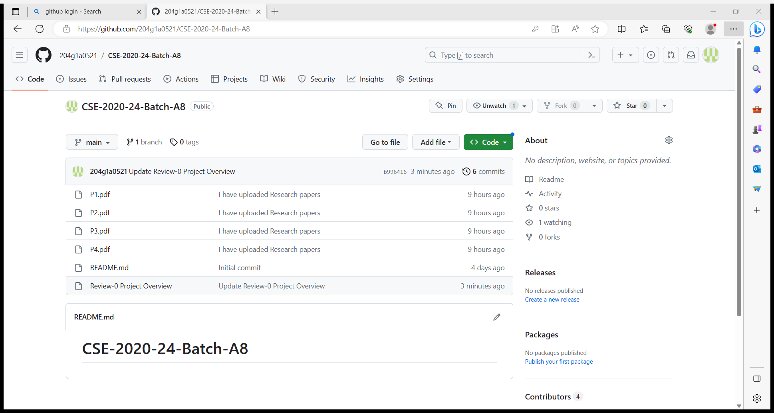
Git Hub Dashboard

Slide 38
Any Queries?

